Slide 1
Pixel
Pixel is the smallest element of an image. Each pixel correspond to any one value. In an 8-bit gray scale image, the value of the pixel between 0 and 255.
The value of a pixel at any point correspond to the intensity of the light photons striking at that point. Each pixel store a value proportional to the light intensity at that particular location.
A pixel is also known as PEL.

Slide 2
Perspective Transformation
When human eyes see near things they look bigger as compare to those who are far away. This is called perspective in a general way.
Whereas transformation is the transfer of an object e.t.c from one state to another.
So overall, the perspective transformation deals with the conversion of 3d world into 2d image. The same principle on which human vision works and the same principle on which the camera works.
We will see in detail about why this happens, that those objects which are near to you look bigger, while those who are far away, look smaller even though they look bigger when you reach them.

Slide 3
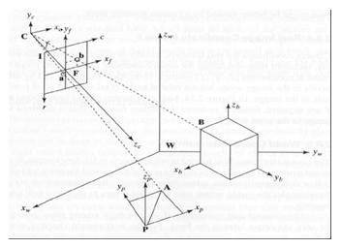
Frame of reference:
Frame of reference is basically a set of values in relation to which we measure something.

Slide 4
5 frames of reference
In order to analyze a 3d world/image/scene, 5 different frame of references are required.
Object
World
Camera
Image
Pixel
1.Object coordinate frame
Object coordinate frame is used for modeling objects. For example, checking if a particular object is in a proper place with respect to the other object. It is a 3d coordinate system.
2.World coordinate frame
World coordinate frame is used for co-relating objects in a 3 dimensional world. It is a 3d coordinate system.
3.Camera coordinate frame
Camera co-ordinate frame is used to relate objects with respect of the camera. It is a 3d coordinate system.

Slide 5
4.Image coordinate frame
It is not a 3d coordinate system, rather it is a 2d system. It is used to describe how 3d points are mapped in a 2d image plane.
5.Pixel coordinate frame
It is also a 2d coordinate system. Each pixel has a value of pixel co ordinates.

Slide 6
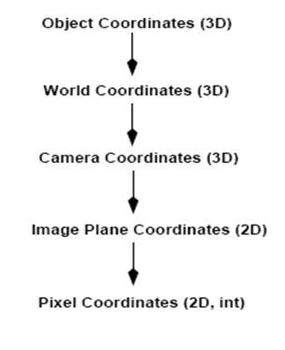
Transformation between these 5 frames
That's how a 3d scene is transformed into 2d, with image of pixels.

Slide 7
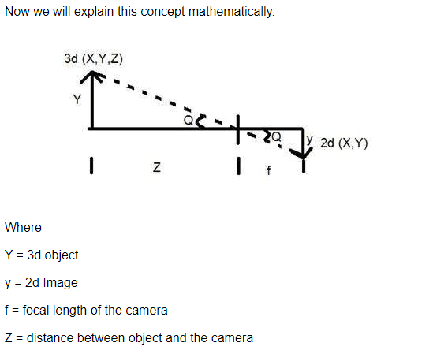

Slide 8
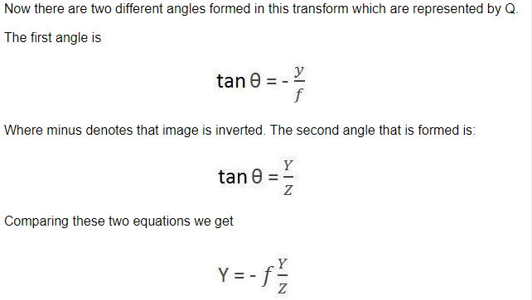
From this equation, we can see that when the rays of light reflect back after striking from the object, passed from the camera, an invert image is formed.

Slide 9
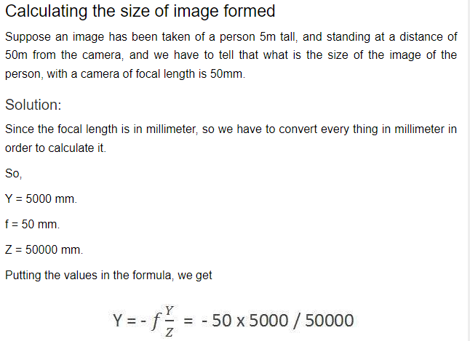
= -5 mm.
Again, the minus sign indicates that the image is inverted.

Slide 10
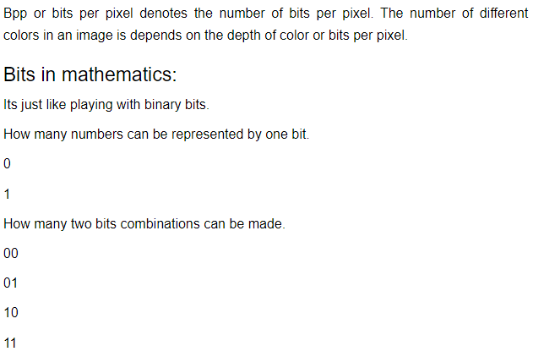
Concept of Bits Per Pixel

Slide 11
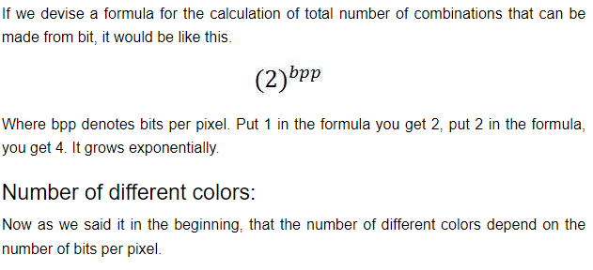

Slide 12
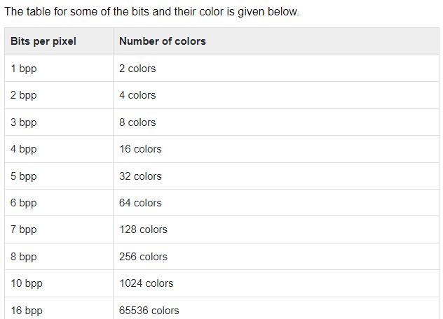

Slide 13
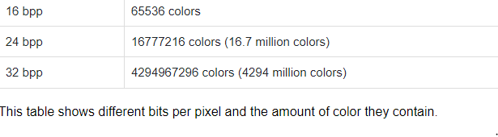

Slide 14
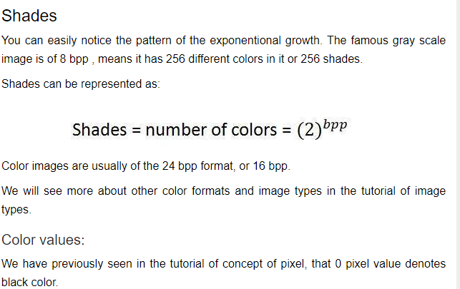

Slide 15
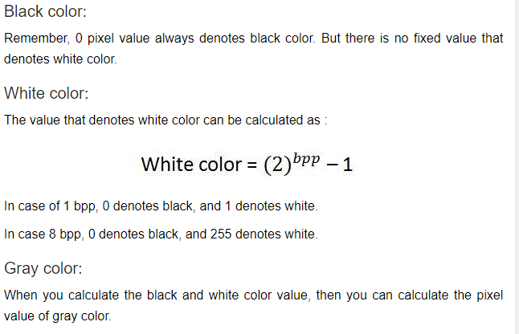

Slide 16
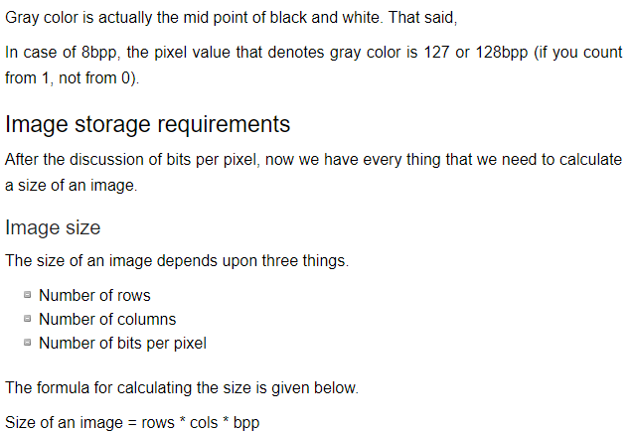

Slide 17
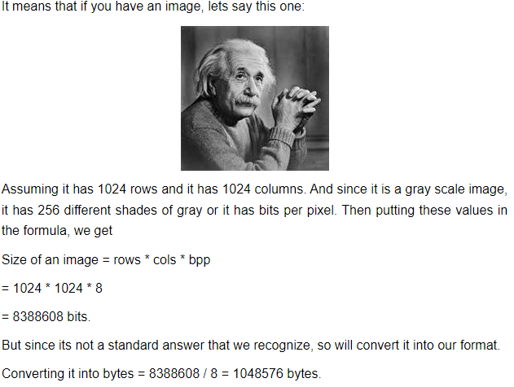
Converting into kilo bytes = 1048576 / 1024 = 1024kb.
Converting into Mega bytes = 1024 / 1024 = 1 Mb.
That is how an image size is calculated and it is stored. Now in the formula, if you are given the size of image and the bits per pixel, you can also calculate the rows and columns of the image, provided the image is square(same rows and same column).

Slide 18
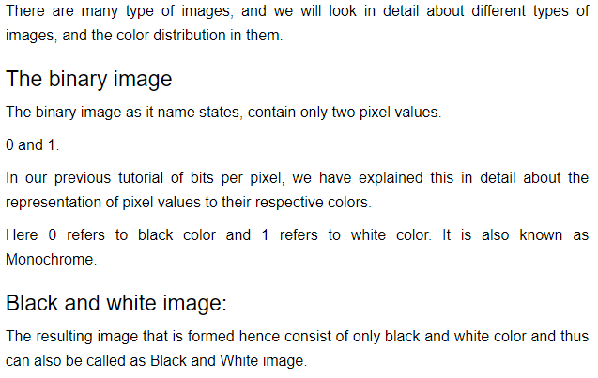
Types of Images

Slide 19
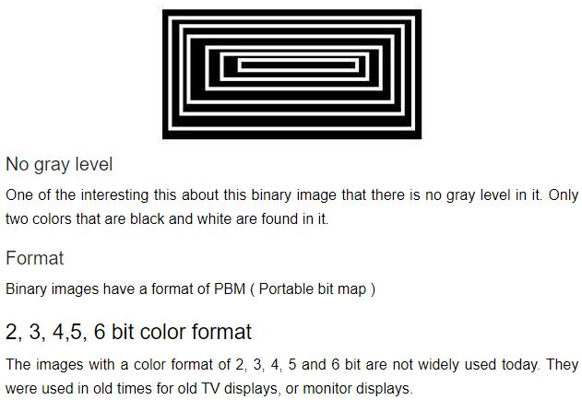

Slide 20
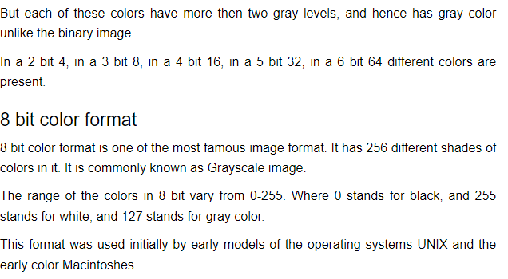

Slide 21
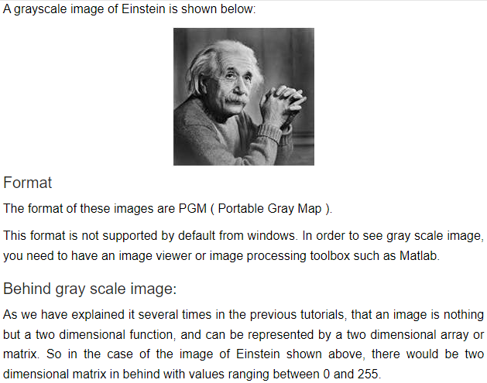

Slide 22
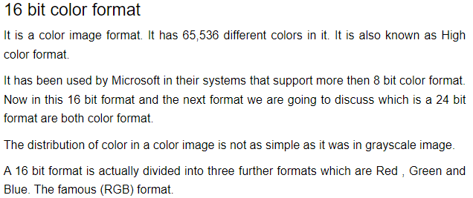

Slide 23
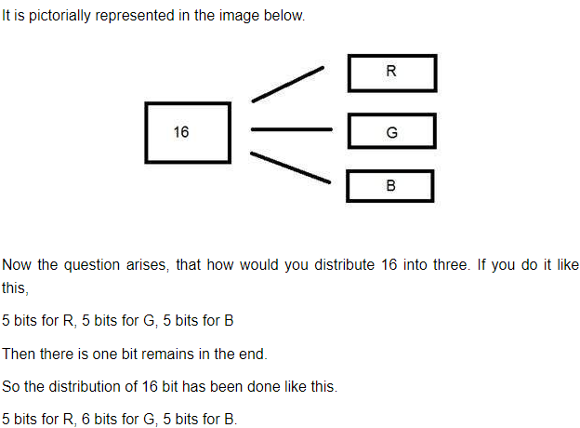

Slide 24
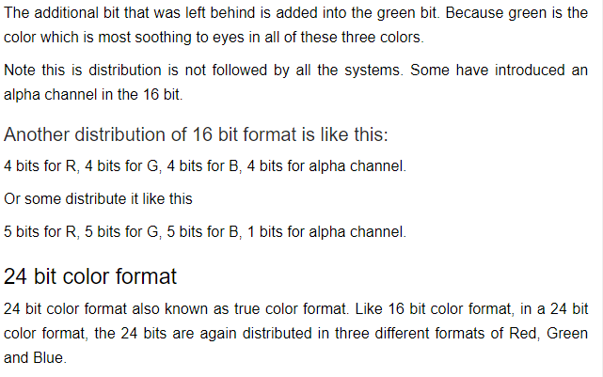

Slide 25
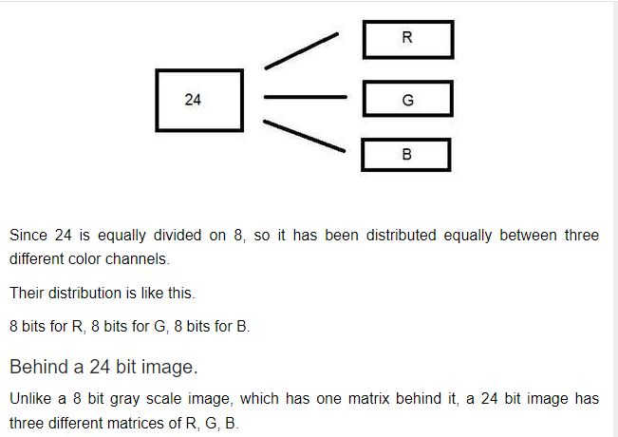

Slide 26
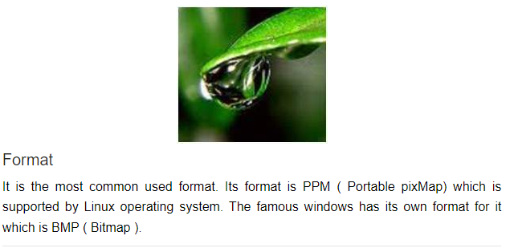

Slide 27
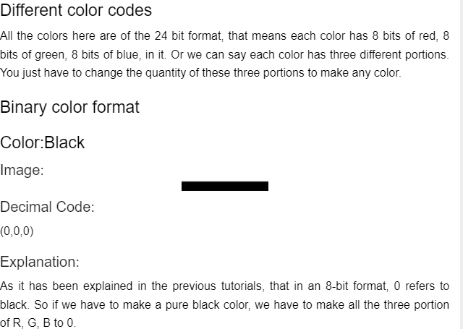
Color Codes Conversion

